Slide 1

California School Climate, Health, and Learning Surveys (CalSCHLS): Progress Update
September 18, 2020
Note: The research reported here was supported by the Institute of Education Sciences, U.S. Department of Education, through Grant R305E150006 to the Regents of the University of California. The opinions expressed are those of the authors alone and do not represent views of the Institute or the U.S. Department of Education, or of the agencies providing data.

Slide 2
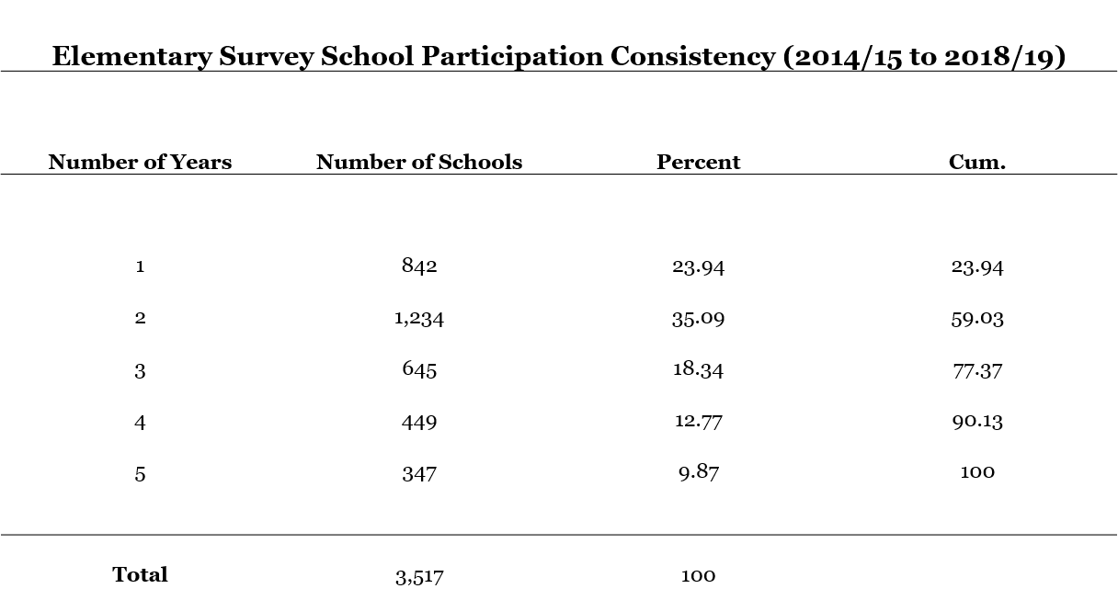
School Participation Consistency: Elementary Survey

Slide 3
School Participation Consistency: Secondary Survey
Secondary Survey School Participation Consistency (2011/12 to 2018/19)
Number of Years | Number of Schools | Percent | Cumulative
1 | 596 | 16.08 | 16.08
2 | 531 | 14.33 | 30.41
3 | 637 | 17.19 | 47.6
4 | 1,060 | 28.6 | 76.2
5 | 435 | 11.74 | 87.94
6 | 243 | 6.56 | 94.5
7 | 124 | 3.35 | 97.84
8 | 80 | 2.16 | 100
Total | 3,706 | 100

Slide 4
School Participation Consistency: Parent Survey
Parent Survey School Participation Consistency (2014/15 to 2018/19)
Number of Years | Number of Schools | Percent | Cumulative
1 | 950 | 32.02 | 32.02
2 | 1,016 | 34.24 | 66.26
3 | 561 | 18.91 | 85.17
4 | 267 | 9 | 94.17
5 | 173 | 5.83 | 100
Total | 2,967 | 100

Slide 5
School Participation Consistency: Staff Survey
Staff Survey School Participation Consistency (2011/12 to 2018/19)
Number of Years | Number of Schools | Percent | Cumulative
1 | 1,674 | 22.13 | 22.13
2 | 1,498 | 19.8 | 41.94
3 | 1,308 | 17.29 | 59.23
4 | 986 | 13.04 | 72.26
5 | 716 | 9.47 | 81.73
6 | 546 | 7.22 | 88.95
7 | 495 | 6.54 | 95.49
8 | 194 | 2.56 | 98.06
9 | 79 | 1.04 | 99.1
10 | 41 | 0.54 | 99.64
11 | 18 | 0.24 | 99.88
12 | 4 | 0.05 | 99.93
13 | 5 | 0.07 | 100
Total | 7,564 | 100

Slide 6
Grade Tabulation: Elementary Survey
Tabulation of Grades in the Elementary Survey Response
 | 2014-2015 |  |  | 2015-2016 |  |  | 2016-2017 |  |  | 2017-2018 |  |  | 2018-2019
Grade | Frequency | Percent |  | Frequency | Percent |  | Frequency | Percent |  | Frequency | Percent |  | Frequency | Percent
3rd | 378 | 0.54 |  | 339 | 0.31 |  | 1238 | 1.31 |  | 2342 | 1.75 |  | 1308 | 1.29
4th | 2505 | 3.55 |  | 2615 | 2.42 |  | 2868 | 3.03 |  | 4364 | 3.27 |  | 2803 | 2.76
5th | 65660 | 93.13 |  | 99763 | 92.51 |  | 87088 | 92.01 |  | 120198 | 90.03 |  | 93564 | 92.19
6th | 1960 | 2.78 |  | 5129 | 4.76 |  | 3459 | 3.65 |  | 6608 | 4.95 |  | 3815 | 3.76
Total | 70503 | 100 |  | 107846 | 100 |  | 94653 | 100 |  | 133512 | 100 |  | 101490 | 100

Slide 7
Grade Tabulation: Secondary Survey
Tabulation of Grades in the Secondary Survey Response
 | 2014-2015 |  |  | 2015-2016 |  |  | 2016-2017 |  |  | 2017-2018 |  |  | 2018-2019
Grade | Frequency | Percent |  | Frequency | Percent |  | Frequency | Percent |  | Frequency | Percent |  | Frequency | Percent
6th | 3732 | 1.07 |  | 5074 | 0.91 |  | 4688 | 0.99 |  | 5315 | 0.82 |  | 5434 | 1.07
7th | 115167 | 33.17 |  | 175756 | 31.5 |  | 145275 | 30.7 |  | 205794 | 31.77 |  | 165956 | 32.59
8th | 7398 | 2.13 |  | 13888 | 2.49 |  | 14672 | 3.1 |  | 15419 | 2.38 |  | 14639 | 2.88
9th | 103731 | 29.87 |  | 167629 | 30.05 |  | 141666 | 29.94 |  | 193787 | 29.92 |  | 148280 | 29.12
10th | 13869 | 3.99 |  | 20250 | 3.63 |  | 18215 | 3.85 |  | 26057 | 4.02 |  | 21796 | 4.28
11th | 84351 | 24.29 |  | 141346 | 25.34 |  | 121194 | 25.61 |  | 162863 | 25.14 |  | 121986 | 23.96
12th | 9829 | 2.83 |  | 15970 | 2.86 |  | 14314 | 3.03 |  | 20123 | 3.11 |  | 18215 | 3.58
Non-traditional | 9140 | 2.63 |  | 17989 | 3.22 |  | 13166 | 2.78 |  | 18364 | 2.84 |  | 12842 | 2.52
Total | 347217 | 100 |  | 557902 | 100 |  | 473190 | 100 |  | 647722 | 100 |  | 509148 | 100

Slide 8
Grade Tabulation: Parent Survey
Tabulation of Grades in the Parent Survey Response
 | 2014-2015 |  |  | 2015-2016 |  |  | 2016-2017 |  |  | 2017-2018 |  |  | 2018-2019
Grade | Frequency | Percent |  | Frequency | Percent |  | Frequency | Percent |  | Frequency | Percent |  | Frequency | Percent
-82 | 1 | 0
-8 | 1327 | 3.49
Kindergarten | 3080 | 8.09 |  | 4171 | 6.22 |  | 11911 | 10.49 |  | 11404 | 7.96 |  | 12442 | 7.98
1st grade | 3183 | 8.36 |  | 4571 | 6.82 |  | 10017 | 8.82 |  | 11590 | 8.09 |  | 12056 | 7.73
2nd grade | 3257 | 8.56 |  | 4884 | 7.29 |  | 9655 | 8.5 |  | 11475 | 8.01 |  | 12512 | 8.02
3rd grade | 3346 | 8.79 |  | 5224 | 7.79 |  | 10720 | 9.44 |  | 12120 | 8.46 |  | 13536 | 8.68
4th grade | 3457 | 9.08 |  | 5802 | 8.66 |  | 11571 | 10.19 |  | 12928 | 9.02 |  | 13554 | 8.69
5th grade | 6658 | 17.49 |  | 8030 | 11.98 |  | 9602 | 8.46 |  | 13989 | 9.76 |  | 16602 | 10.64
6th grade | 3022 | 7.94 |  | 5033 | 7.51 |  | 7498 | 6.6 |  | 10404 | 7.26 |  | 11770 | 7.55
7th grade | - | - |  | 5798 | 8.65 |  | 7780 | 6.85 |  | 10916 | 7.62 |  | 12568 | 8.06
8th grade | 2042 | 5.37 |  | 4635 | 6.92 |  | 6660 | 5.87 |  | 9300 | 6.49 |  | 9940 | 6.37
9th grade | 2410 | 6.33 |  | 5516 | 8.23 |  | 7261 | 6.39 |  | 10302 | 7.19 |  | 10899 | 6.99
10th grade | 2273 | 5.97 |  | 4465 | 6.66 |  | 6556 | 5.77 |  | 9154 | 6.39 |  | 9417 | 6.04
11th grade | 2168 | 5.7 |  | 4946 | 7.38 |  | 7455 | 6.57 |  | 9928 | 6.93 |  | 10262 | 6.58
12th grade | 1513 | 3.98 |  | 3461 | 5.16 |  | 5628 | 4.96 |  | 8096 | 5.65 |  | 8332 | 5.34
Other | 225 | 0.59 |  | 380 | 0.57 |  | 969 | 0.85 |  | 1346 | 0.94 |  | 1740 | 1.12
Ungraded | 99 | 0.26 |  | 108 | 0.16 |  | 262 | 0.23 |  | 350 | 0.24 |  | 342 | 0.22
Total | 38061 | 100 |  | 67024 | 100 |  | 113545 | 100 |  | 143302 | 100 |  | 155972 | 100

Slide 9
Grade Tabulation: Staff Survey
Tabulation of Teacher Classifications in the Staff Survey
 | 2014-2015 |  |  | 2015-2016 |  |  | 2016-2017 |  |  | 2017-2018 |  |  | 2018-2019
 | Frequency | Percent |  | Frequency | Percent |  | Frequency | Percent |  | Frequency | Percent |  | Frequency | Percent
Grade 4 or Below | 15150 | 45.79 |  | 25068 | 46.33 |  | 18980 | 41.58 |  | 14010 | 20.61 |  | 12456 | 23.01
Grade 5 or Above | 7300 | 22.06 |  | 10808 | 19.97 |  | 10053 | 22.03 |  | 28070 | 41.3 |  | 20568 | 37.99
Both of the above | 396 | 1.2 |  | 648 | 1.2 |  | 510 | 1.12 |  | 793 | 1.17 |  | 702 | 1.3
Special Education | 2761 | 8.34 |  | 4276 | 7.9 |  | 3649 | 7.99 |  | 5560 | 8.18 |  | 4457 | 8.23
Total | 33088 |  |  | 54112 |  |  | 45642 |  |  | 67961 |  |  | 54142
Note: Only teacher classifications are included. There are other staff classifications not shown here.

Slide 10
Question Consistency: Staff Survey
At a glance…
2018/19 and 2017/18 use the same survey
2014/15 to 2016/17 use pretty much the same survey
Change in survey between 2016/17 and 2017/18

Slide 11
Question Consistency: Staff Survey
This school ...
10. provides adequate counseling and support services for students.
Consistent over 1819, 1718, 1617, 1516, 1415
20. encourages students to enroll in rigorous courses (such as honors and AP), regardless of their race, ethnicity, or nationality.
Consistent over 1819, 1718, 1617, 1516, 1415
24. has high expectations for all students, regardless of their race, ethnicity, or nationality.
Consistent over 1819, 1718
1617, 1516, 1415 does not have the question. Q23 is “This school considers closing the racial/ethnic achievement gap a high priority. “ and Q24 is “This school fosters an appreciation of student diversity and respect “for each other.

Slide 12
Question Consistency: Staff Survey
In this school, adults ...
41. feel a responsibility to improve this school.
Consistent over 1819, 1718
Equivalent question is Q42 in 1617, 1516, 1415: “How many adults at this school feel a responsibility to improve this school?” Answers: “Nearly All, most, some, few, almost none”
This school ...
44. motivates students to learn.
Consistent over 1819, 1718
Not included in 1617, 1516, 1415

Slide 13
Question Consistency: Staff Survey
Please indicate how much you agree or disagree with the following statements about your school...
64. Students are motivated to learn.
Consistent over 1819, 1718
Equivalent question in 1617, 1516, 1415 is Q72: “This school… motivates student to learn”. Difference is answer options here include “Not Applicable”
Similar question in 1617, 1516, 1415 is Q56: “Based on your experience, how many students at this school... are motivated to learn?”
87. Teachers at this school communicate with parents about what their children are expected to learn in class.
Consistent over 1819, 1718
Equivalent question in 1617, 1516 is Q113: “Please indicate how much you agree or disagree with the following statement about your school: Teachers at this school communicate with parents about what their children are expected to learn in class”. Difference is answer options here include “Not Applicable”
Not included in 1415

Slide 14
Question Consistency: Staff Survey
How much of a problem AT THIS SCHOOL is ...
98. cutting classes or being truant?
Consistent over 1819, 1718
Equivalent question in 1617, 1516, 1415 is Q66: “How much of a problem AT THIS SCHOOL is… cutting classes or being truant?”

Slide 15
Question Consistency: Staff Survey
Do you feel that you need more professional development, training, mentorship, or other support to do your job in any of the following areas?
103. meeting academic standards
Consistent in 1819, 1718
Same question in 1617, 1516, 1415 is Q44: “Do you feel that you need more … meeting academic standards” with the addition of answer choice “Not Applicable” if “the indicated training is not needed for your job”
104. evidence–based methods of instruction
Consistent in 1819, 1718
Same question is Q45 in 1617, 1516, 1415 with the addition of answer choice “Not Applicable” if “the indicated training is not needed for your job”
105. positive behavioral support and classroom management
Consistent in 1819, 1718
Same question is Q46 in 1617, 1516, 1415 with the addition of answer choice “Not Applicable” if “the indicated training is not needed for your job”

Slide 16
Question Consistency: Staff Survey
109. closing the achievement gap
Consistent in 1819, 1718
Same question is Q50 in 1617, 1516, 1415 with the addition of answer choice “Not Applicable” if “the indicated training is not needed for your job”
111. meeting the social, emotional, and developmental needs of youth (e.g., resilience promotion)
Consistent in 1819, 1718
Same question is Q52 in 1617, 1516, 1415 with the addition of answer choice “Not Applicable” if “the indicated training is not needed for your job”
112. creating a positive school climate
Consistent in 1819, 1718
Same question is Q53 in 1617, 1516, 1415 with the addition of answer choice “Not Applicable” if “the indicated training is not needed for your job”

Slide 17
Question Consistency: Staff Survey
This school ...
128. provides counseling or other ways to help students with their social-emotional needs.
Consistent in 1819, 1718
Similar question in 1617, 1516, 1415 is Section 2, Q13: “This school… emphasizes helping students with their social, emotional, and behavioral problems”.

Slide 18
Work in Progress
Question consistency in Parent Survey
Survey response rate and representativeness

Slide 19
Thank you!
California Department of Education
Jonathan Isler
Ryan Fuller
California Community Colleges Chancellor’s Office
Gary Adams
Todd Hoig
California State University Chancellor’s Office
Ed Sullivan
Matthew Case
Note: The research reported here was supported by the Institute of Education Sciences, U.S. Department of Education, through Grant R305H150073 to the Regents of the University of California. The opinions expressed are those of the authors and do not represent views of the Institute or the U.S. Department of Education, or of the agencies providing data.

